Slide 1



DEVELOPING APPLICATIONS TO HELP INDIVIDUALS AND ORGANIZATIONS TRACK AND REDUCE THEIR CARBON FOOTPRINT
satwik.vnr@gmail.com. Satwik Reddy K. +91 9542583550

Slide 2

PROBLEM STATEMENT
The technology industry has a significant impact on the environment, with software development being one of the biggest contributors. The growing demand for technology has led to an increase in energy consumption and carbon emissions, which have adverse effects on the environment. Green software is a new approach to software development that aims to reduce the environmental impact of technology.
The challenge is to build intelligent tools and frameworks that will guide and enable developers and the larger tech community to design and build green code. These tools and frameworks should be intuitive and provide developers with recommendations and best practices to reduce carbon footprint spanning the entire software development life cycle (SDLC).

Slide 3
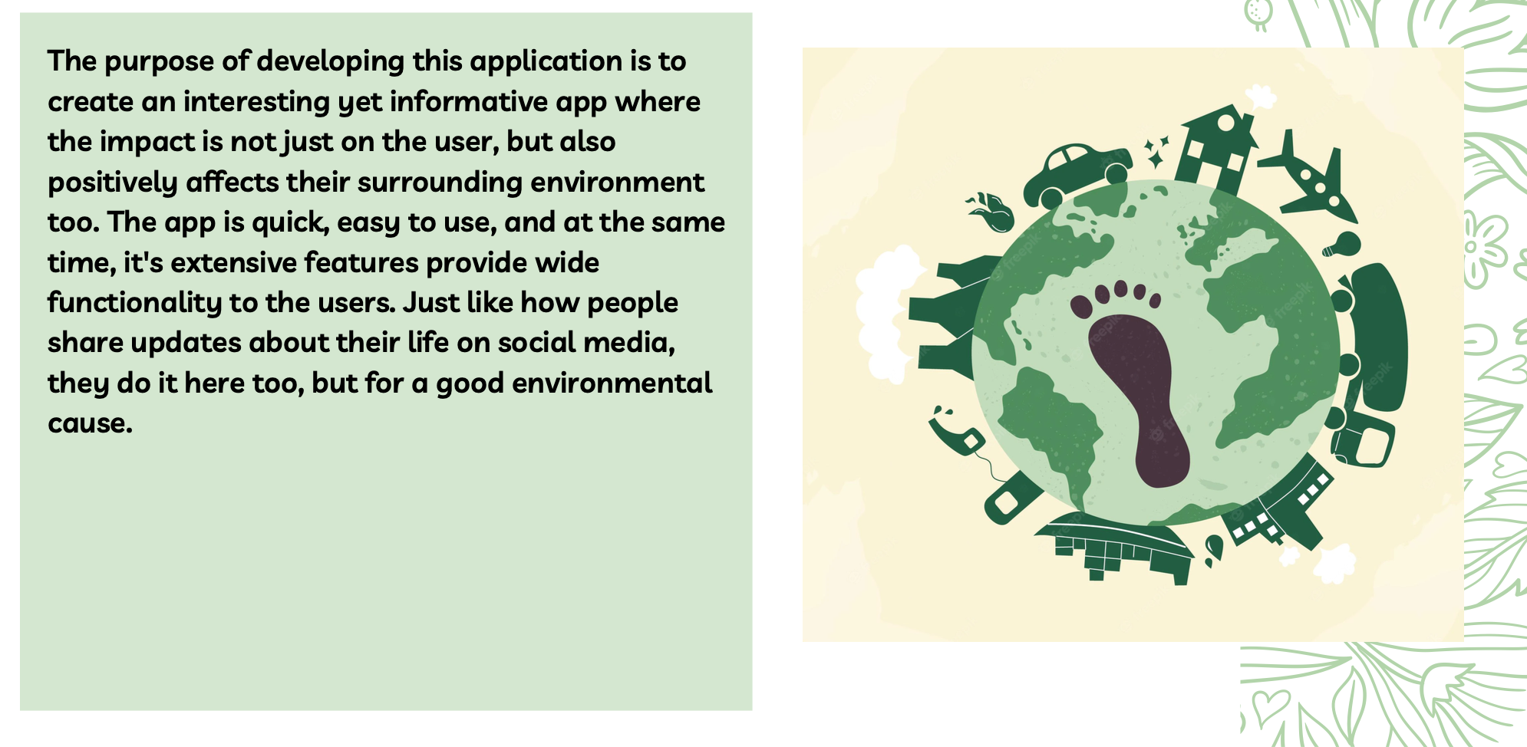
User Segment & Pain Points
People, especially the youth in this generation needs something quick, easy to interpret, and yet impactful.
The people need an 'Info-Tainment' approach to actually use a platform and monitor their performance.
So making an app that goes with the GenZ style is the most preferred one as they are the future and going in their world and making them understand the problems would make more sense and improve the scope of this app.

Slide 4
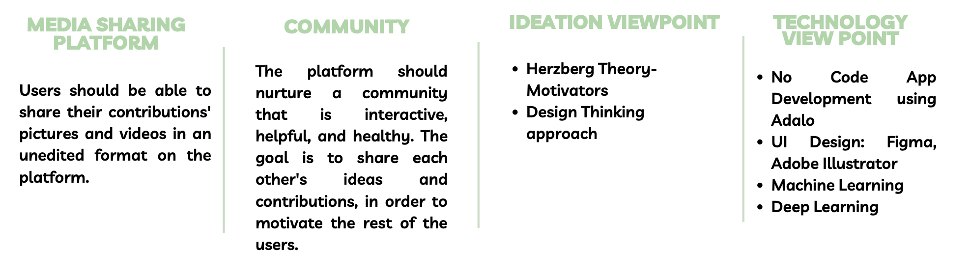
Tools or resources

Slide 5
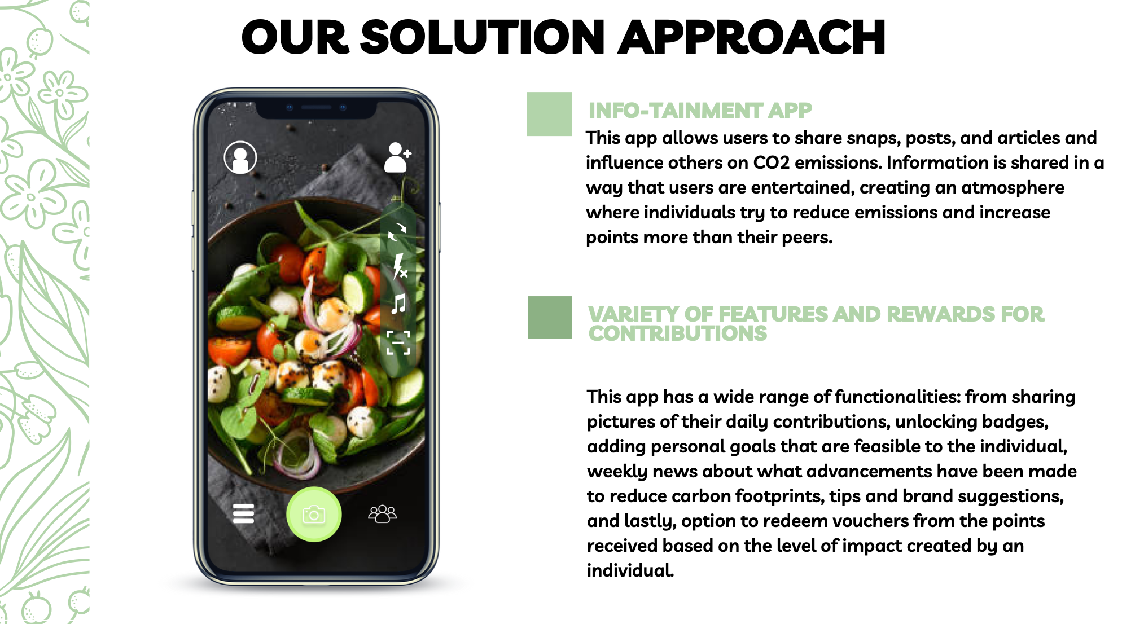
Any Supporting Functional Documents

Slide 6
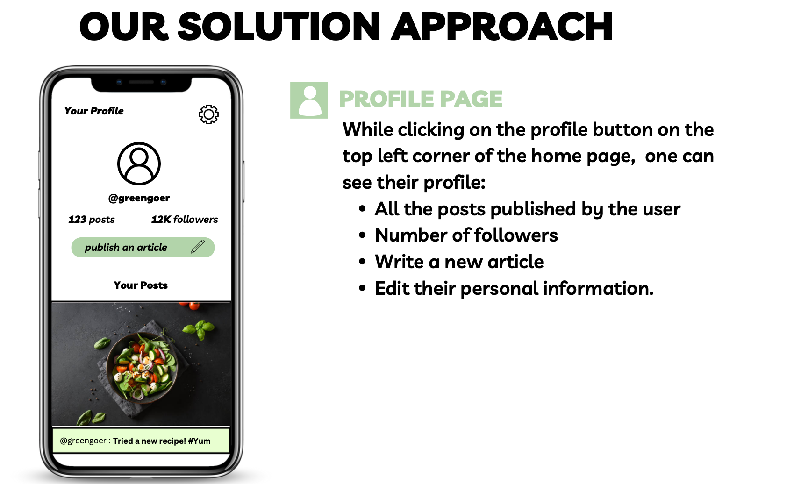
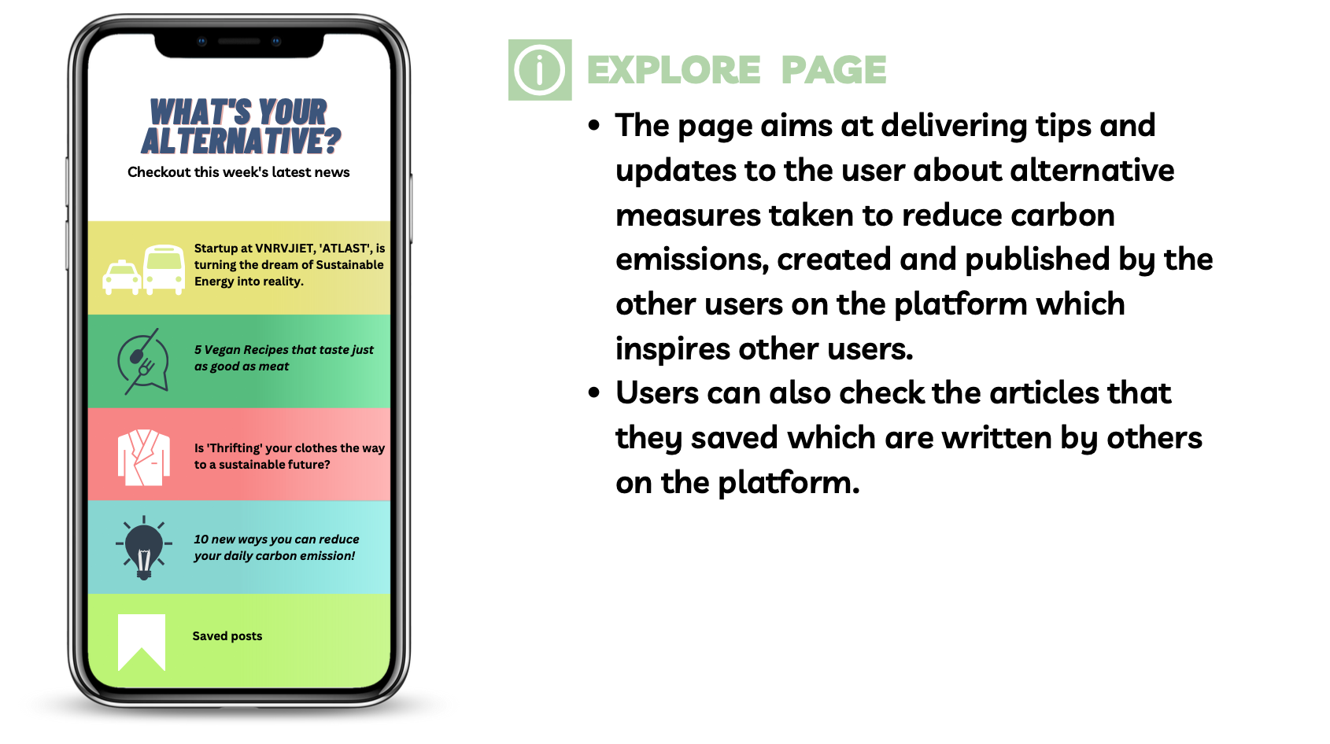
Key Differentiators & Adoption Plan

Slide 7
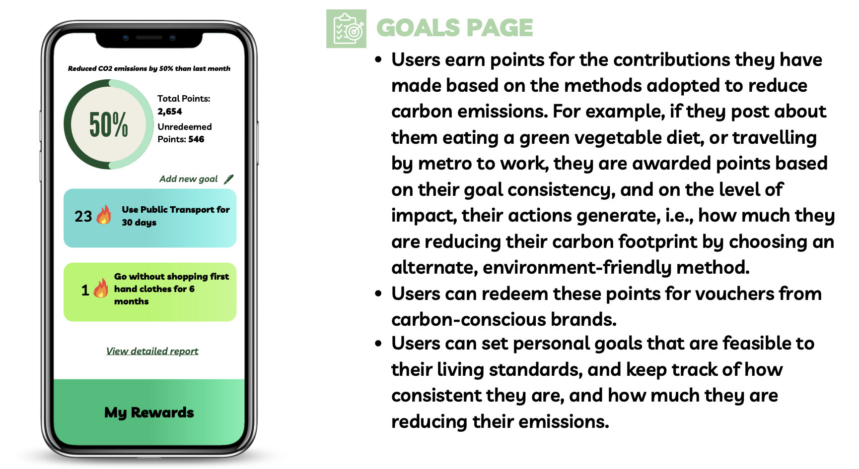
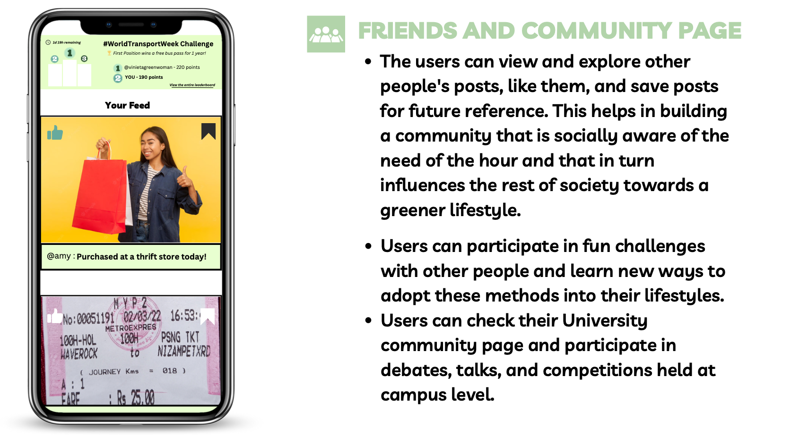

Slide 8


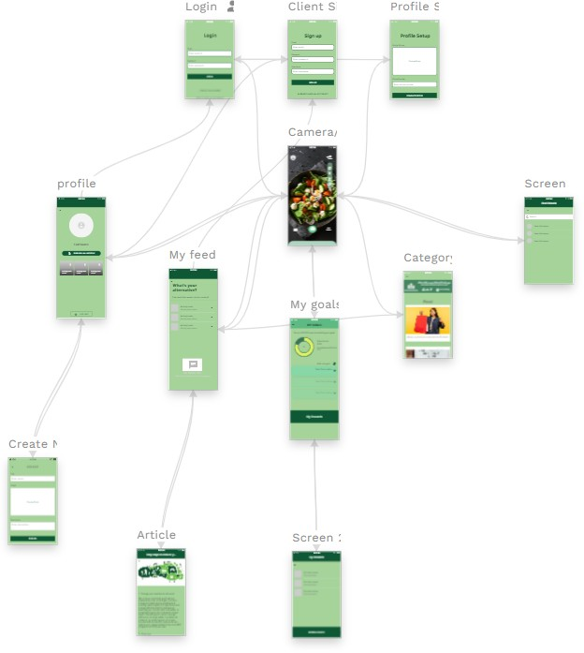
PROJECT DESIGN MAP
USING ADALO

Slide 9

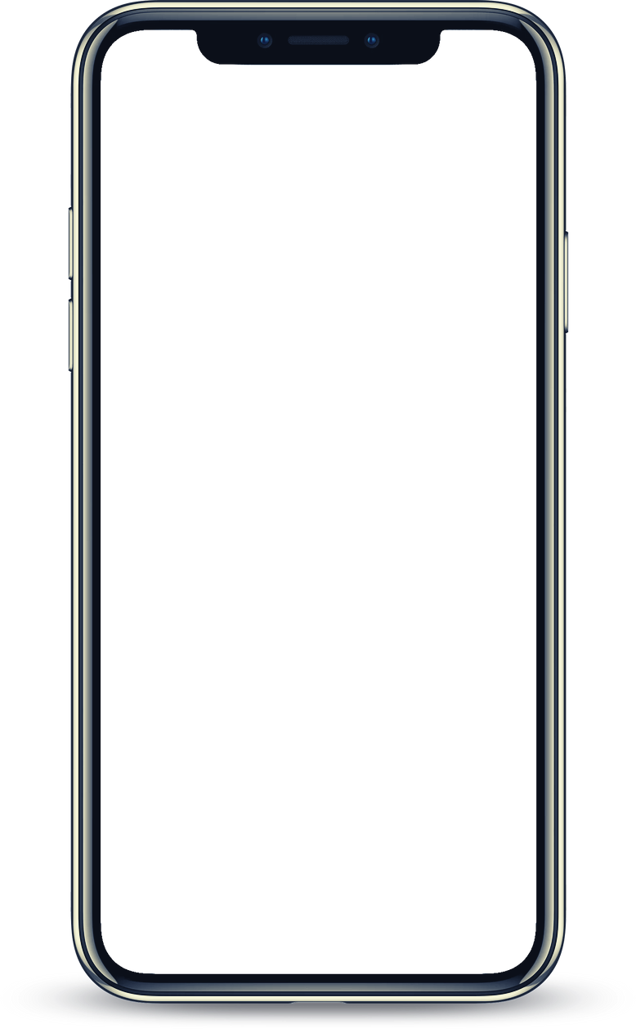
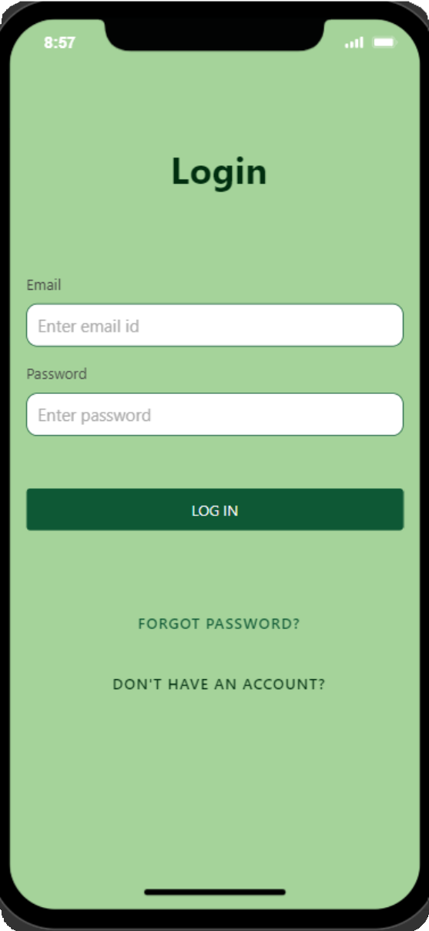
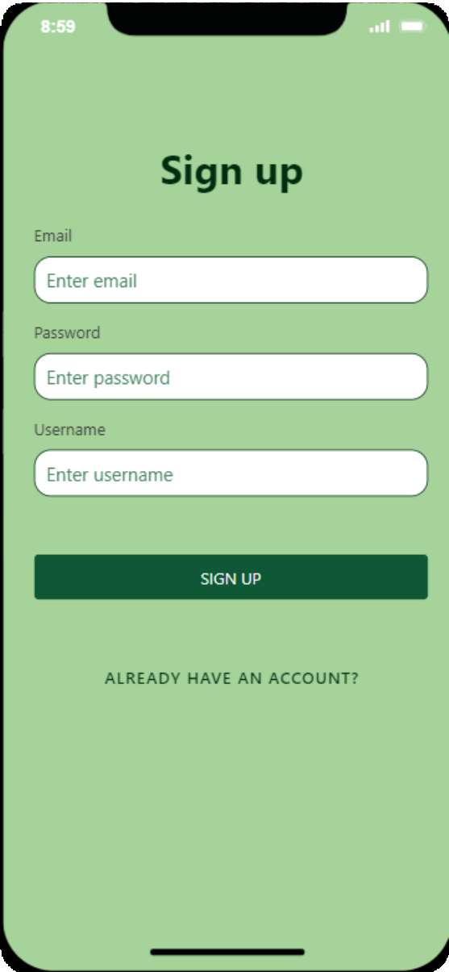
OUR INNOVATIVE SOLUTION

Slide 10

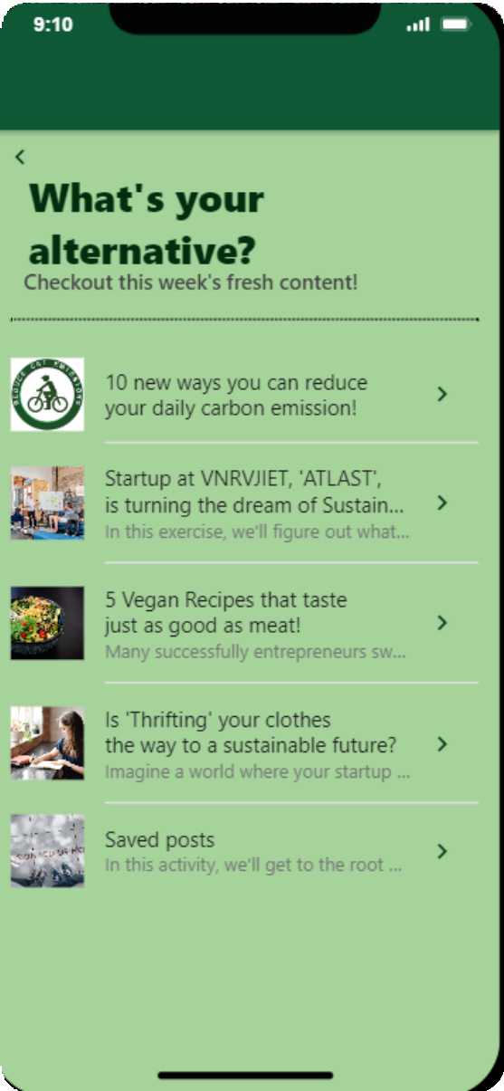

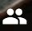
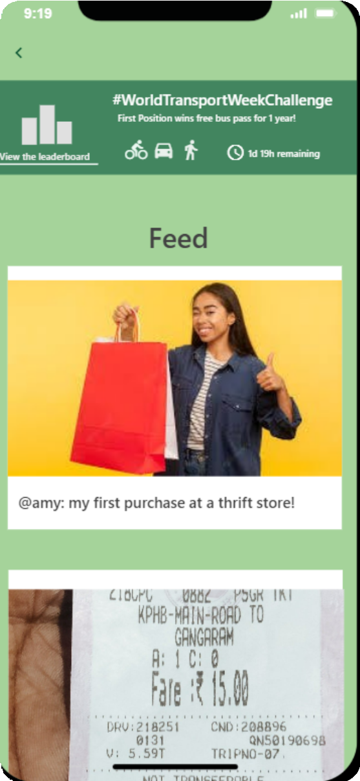
OUR INNOVATIVE SOLUTION

Slide 11

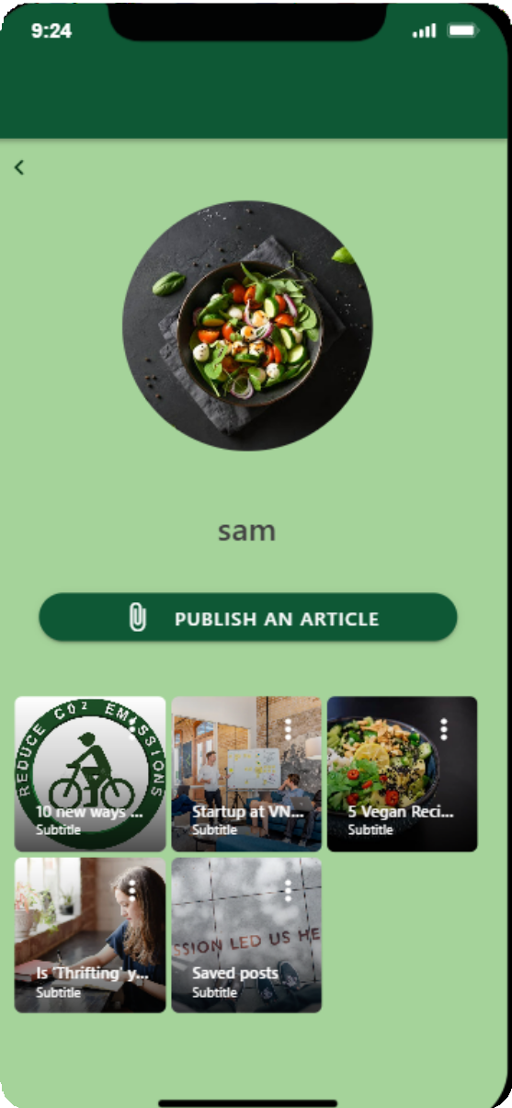
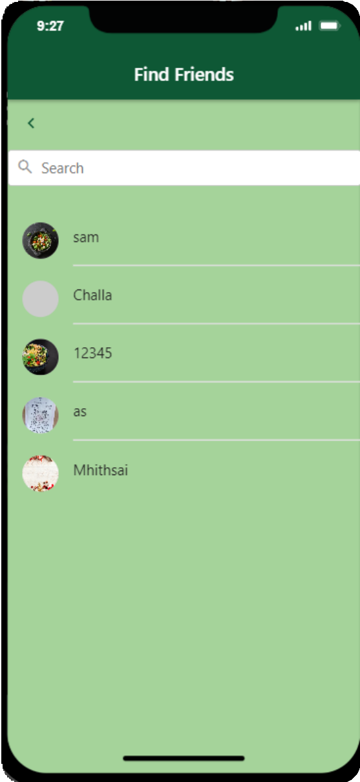


OUR INNOVATIVE SOLUTION

Slide 12
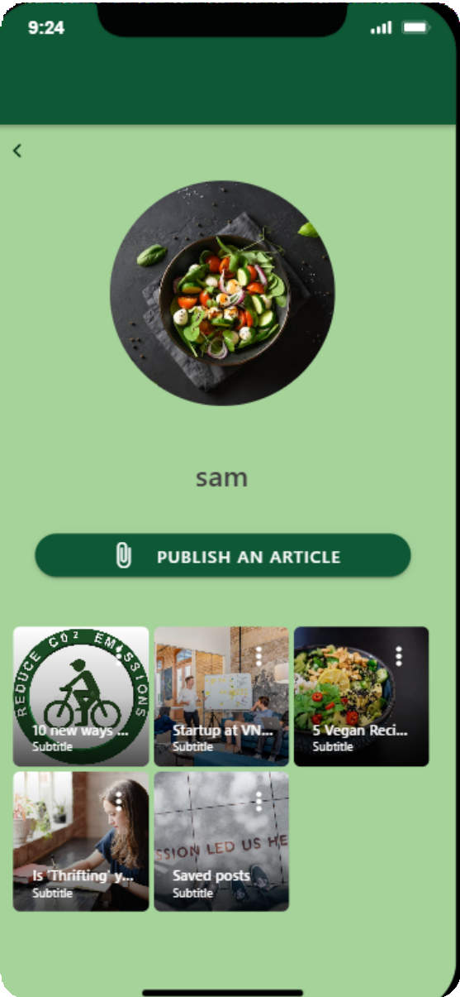

OUR INNOVATIVE SOLUTION

Slide 13
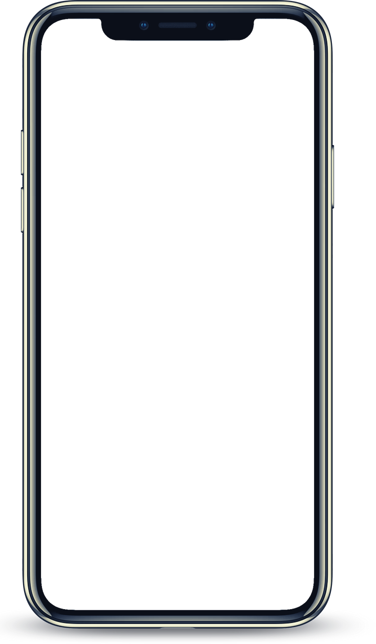
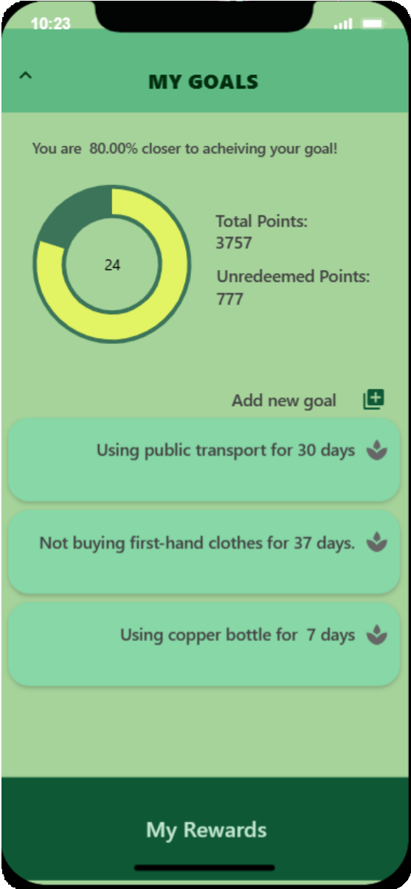
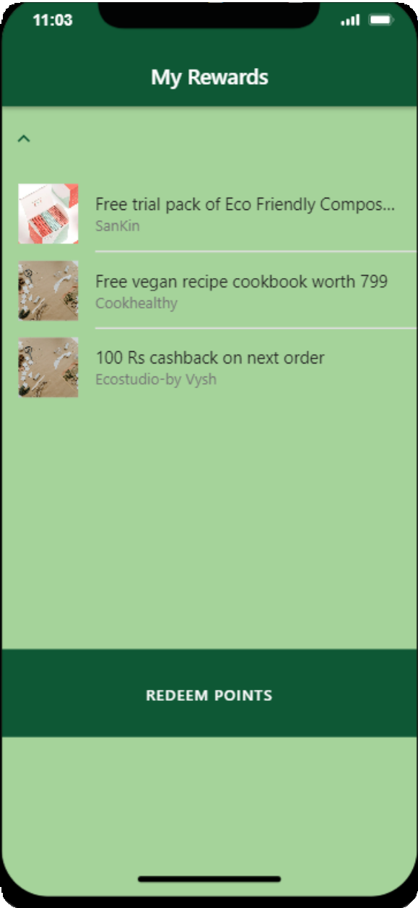
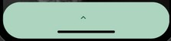

OUR INNOVATIVE SOLUTION

Slide 14
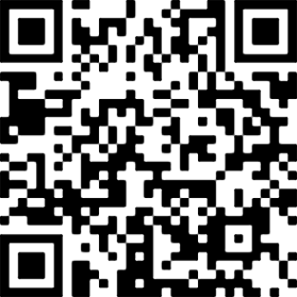
Go EcoSnap!
GO GR E E N !
Scan to use our app

Slide 15

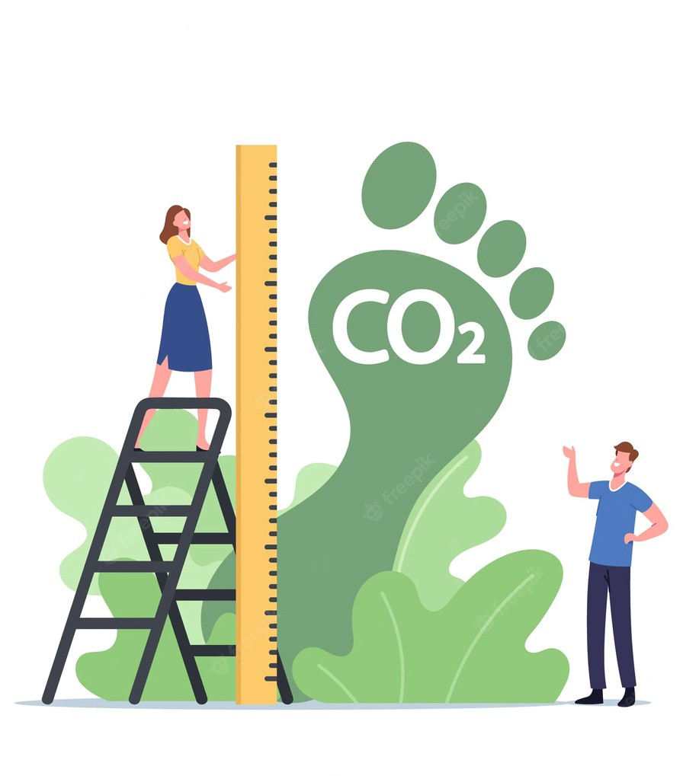
FUTURE SCOPE
Making advancements to the scope of the application is essential to keep up with the changing consumer habits, and evolving technologies. Some of our ideas for the future are:
Creating an Online Thrift platform for each city, where users from the city can buy pre-used clothes that are in good condition from each other, and collect it from a pickup location, which avoids the concept of sending via mail, hence reducing the carbon footprint.
Create a connectivity between students of the same college, where they can connect with people to carpool and save fuel, create less harm.
On a corporate social responsibility perspective, for a high level badge earned by the user, a sapling could be planted for them, or monetary contribution towards endangered species could be done, as a token of appreciation.

Slide 16

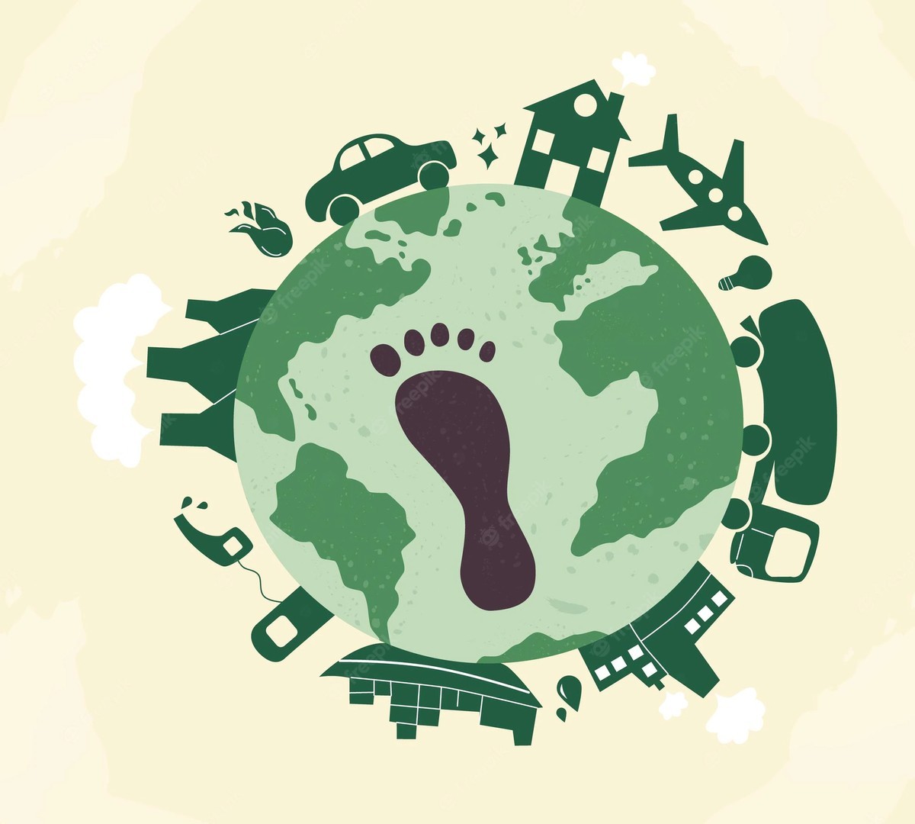
CONCLUSION
The purpose of developing this application is to create an interesting yet informative app where the impact is not just on the user, but also positively affects their surrounding environment too. The app is quick, easy to use, and at the same time, it's extensive features provide wide functionality to the users. Just like how people share updates about their life on social media, they do it here too, but for a good environmental cause.

Slide 17

THANK YOU

